Slide 1
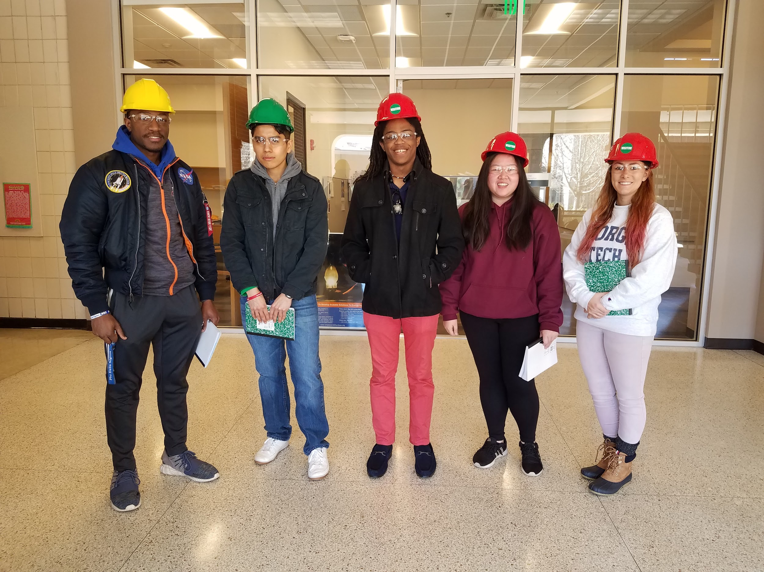
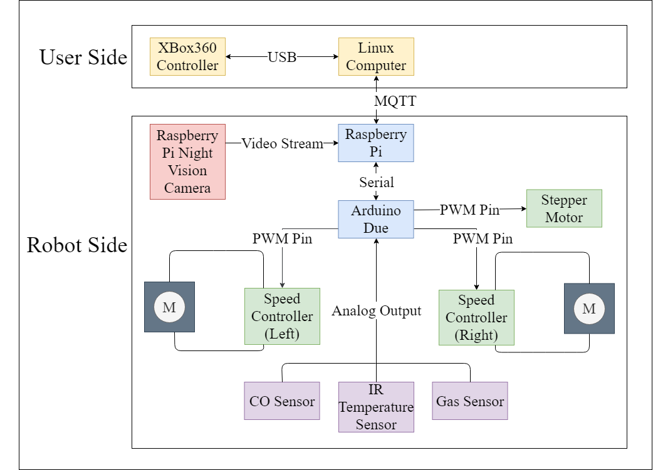
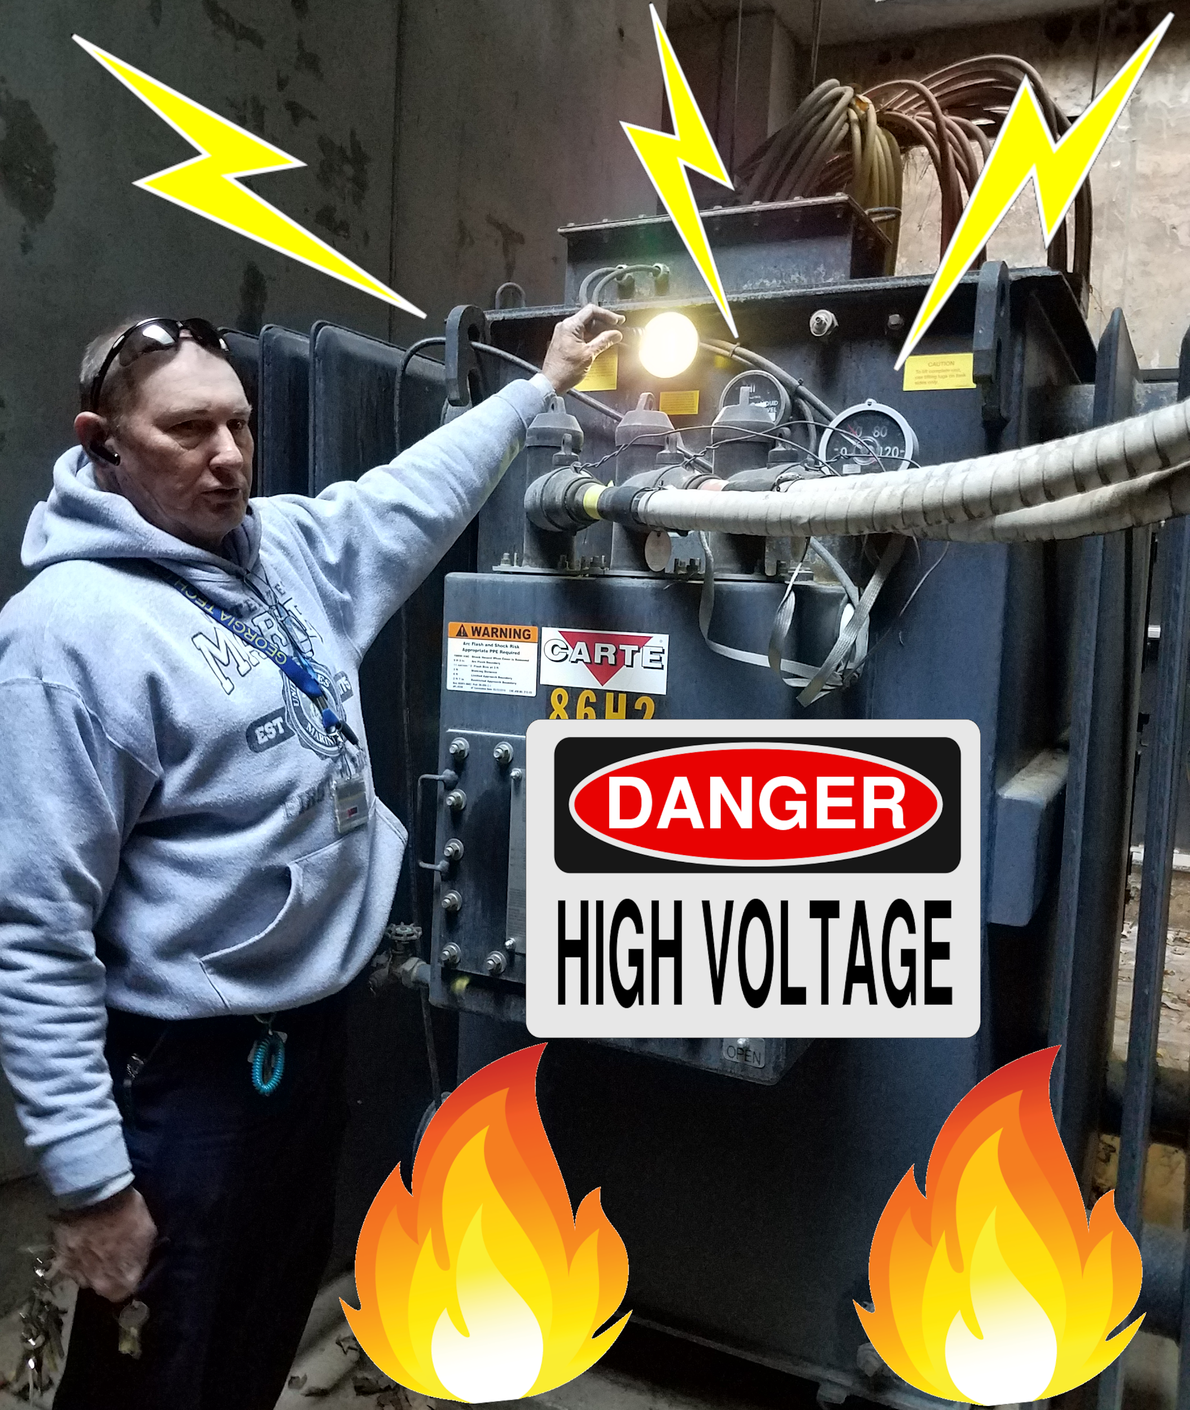
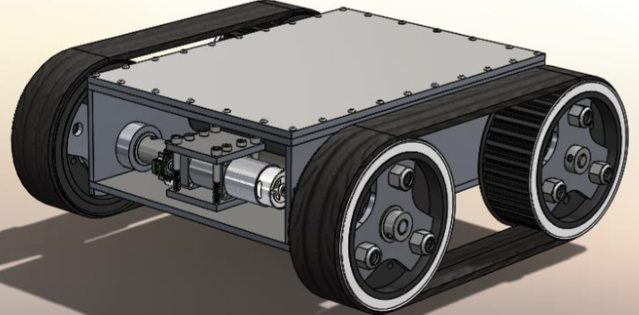
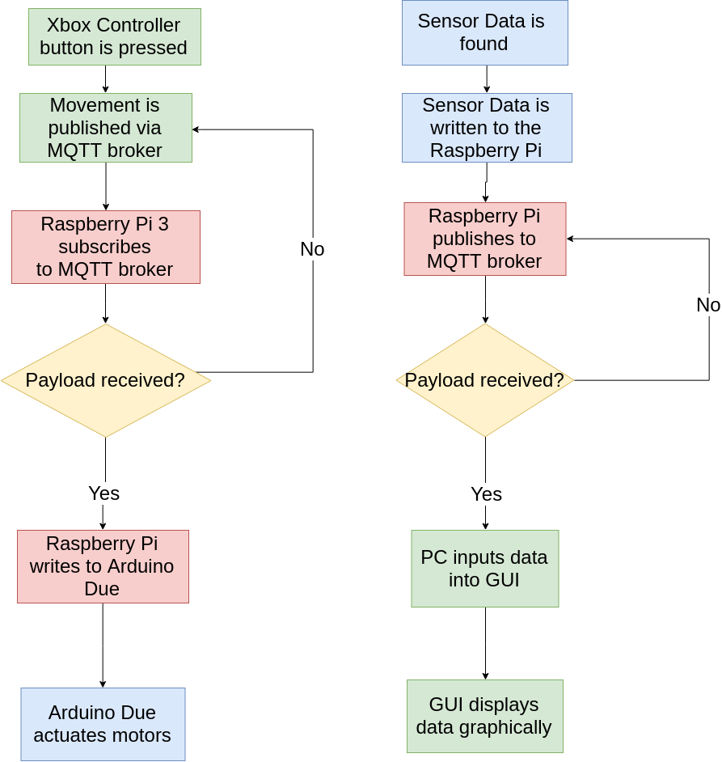
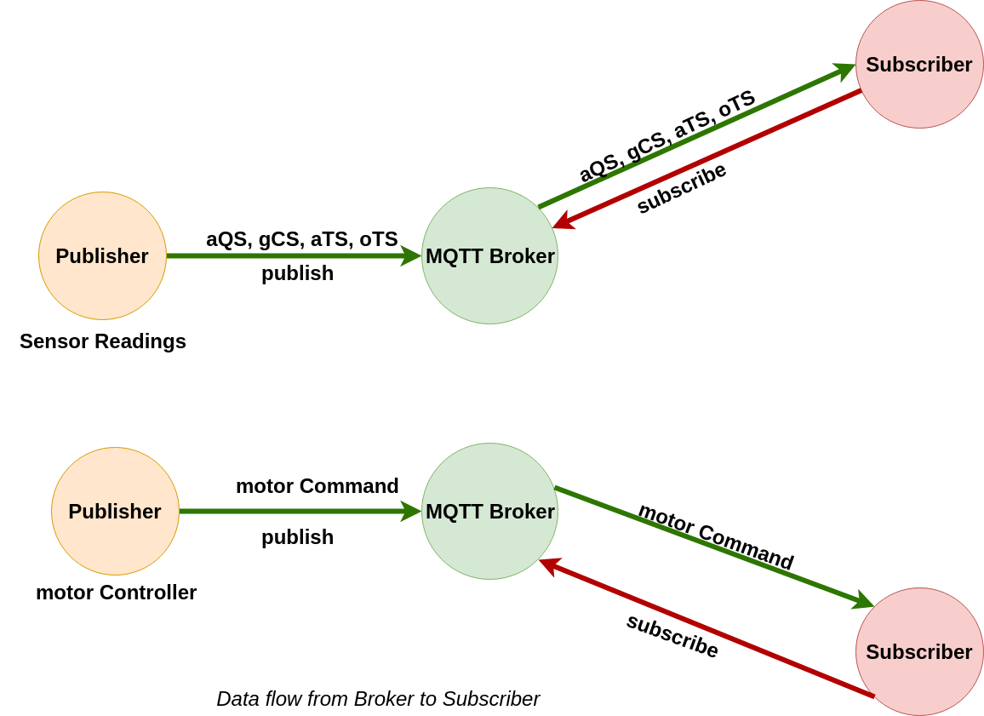
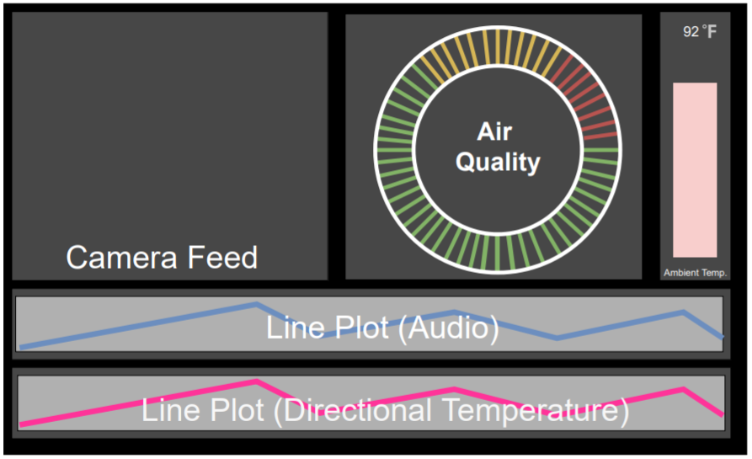
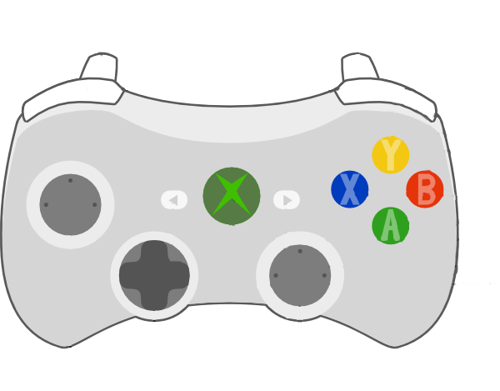
Powervault Inspection Robot
Stephanie Chan, Elizabeth Fuller, Adrian Muñoz, Nelson Raphael, Lemek Robinson
Advisor: Lukas Graber
Design a remote controlled robot that inspects power vaults
Create a user-friendly GUI for inspection workers to use
Assemble a sensor package to examine the quality of the environment using video and gas sensors
Design Overview
Objectives
Hardware
A pulley system lifts a platform which holds the sensor package and camera
Protect inspection
workers from the dangers
of powervaults
Electrical parts are
responsible for 80%
of electrocution deaths
among workers
Simplify the process of
logging data while
inspecting powervaults
The base of the lift is a turntable to enable rotation
Motivation
The 6 foot lift is mounted to the robot body
Software
GUI
An Xbox 360 controller is used to operate the robot’s movement
Controller Diagram
(Insert diagram of gui)
Reset
Diagrams for MQTT protocols for motor control and GUI data transfer.
Left Motor Control
Collapsible lift to increase mobility and stability
Write a training manual to improve user-friendliness
Implement audio capture into the hardware design
Future Work
Lift and Rotation Control
Right Motor Control
Notes:
½ inch margins
36 px for titles
30 pt for text
Dark blue 3 for box outline / light yellow 1 for title color fill
Format Border design - make it square

